Slide 2
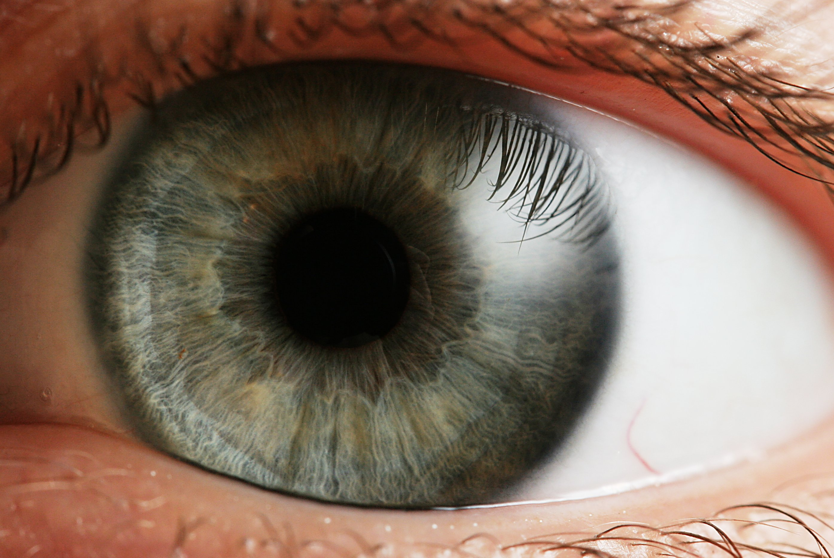
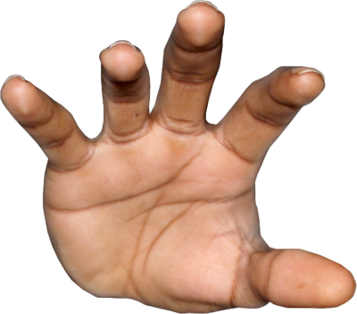
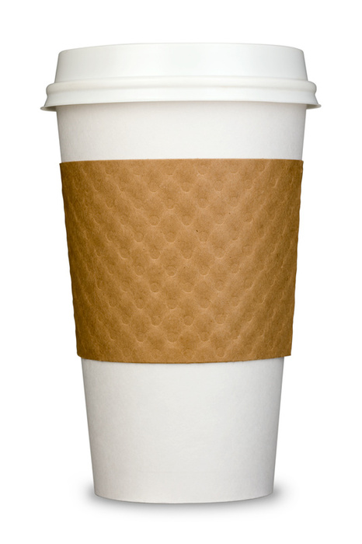
6cm ± 2cm
size?
4cm ± 1cm
Notes:
what’s the best guess? Is it closer to 4 or 6? Do you think there’s MORE uncertainty, or LESS?

Slide 3
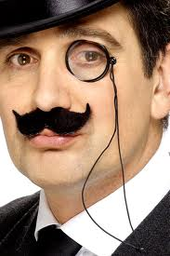
6cm ± 0.5cm
size?
4cm ± 1cm
Notes:
what about after I remember to put in my monocle, and my margin of error on my visual estimate goes down to a half a centimeter?

Slide 4
probability
size (cm)

Slide 5
probability
size (cm)

Slide 6
Does the brain really do this?
Important to make predictions about behavior based on model.
Qualitative predictions: “when I increase x, y should also increase”
Quantitative predictions: “if I measure this thing, it will have value x”

Slide 7
An experiment!

Slide 8
Decide which of two objects are bigger.
One object has a cue conflict: felt and seen size are mismatched.
Cue combination predicts:
More reliable cue is weighted more
Weights are directly proportional to reliability
Reliability of two cues sums.

Slide 9
Notes:
(walk through this slowwwwly)

Slide 10
Bayesian modeling
Represent uncertain information
Everything is a probability distribution
Usually describe optimal performance for a task, given certain information and assumptions about task structure.
Not always directly related to actual cognitive processing or neural activity.

Slide 11
How to make a model
Start with a theory
“People combine information about size from different senses by weighting each sense according to its reliability”
Express the theory quantitatively
Information is a probability distribution
Reliability is the inverse variance of that distribution.

Slide 12
Backwards blocking/ Explaining away

Slide 13
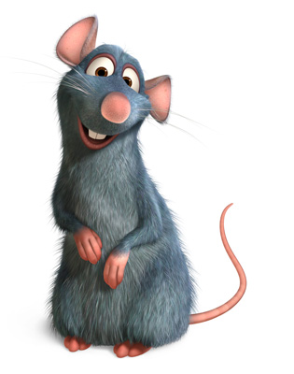



Phase 1
+
+

Slide 14

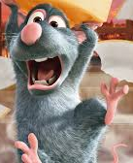
Phase 1: test
+
+

Slide 15
Phase 2
+

Slide 16
Phase 2: test
+

Slide 17
Explaining away & backward blocking
Bayesian model:
Cue weights (how well cue predicts shock), sum to 1.
After exposure to light+sound+shock, could be anywhere from all light to all sound and mixtures in between.
After exposure to sound+shock, high weight for sound is supported, and hence weight for light drops.
Notes:
Okay, again, a little silly. but if you replace your aunt and uncle with a flashing light and a buzzer, and the $20 with food, and you run the experiment on rats, then you have “backwards blocking”, which gave behaviorists a lot of headaches. because an association between cue and reward changes without ever observing anything about that cue. it really looks like people (rats) are re-evaluating their previous experience with the help of mental representations.

